Slide 1
PhonePe Pulse Data Analysis Dashboard

Slide 2
Agenda
Project Overview
Technology Stack
Dataset Structure
Data Pipeline
Exploratory Data Analysis
Dashboard Demo
Key Insights & Future Improvements

Slide 3
Project Overview
Analyze digital payment trends in India using PhonePe Pulse dataset
Build an interactive dashboard using Streamlit
Understand transaction growth, user engagement, and insurance adoption
Identify high-performing states, districts and pincodes

Slide 4
Key Objectives
Analyze transaction value and volume across India
Study user registration and engagement patterns
Identify high digital payment adoption regions
Explore insurance usage trends
Create an interactive dashboard for visualization

Slide 5
Complete Analytics Pipeline
GitHub JSON Data
Python + Pandas
MySQL Database
SQL Queries
Streamlit Dashboard

Slide 6
Technology Stack
Category | Tools
Language | Python
Processing | Pandas, JSON
Database | MySQL
Visualization | Streamlit, Plotly, Matplotlib
Development | Jupyter Notebook, GitHub

Slide 7
Dataset Structure
Category | Purpose | Tables
Aggregated Data | State-level summaries | aggregated_user / aggregated_transaction / aggregated_insurance
Map Data | District-level insights | map_user / map_transaction / map_insurance
Top Data | Top performing regions | top_user / top_transaction / top_insurance

Slide 8
Exploratory Data Analysis
Transaction Analysis – identify high-value states
User Engagement – analyze registrations and app opens
Insurance Analysis – study adoption patterns
District Analysis – identify top districts by transactions
User Registration – understand regional growth

Slide 9
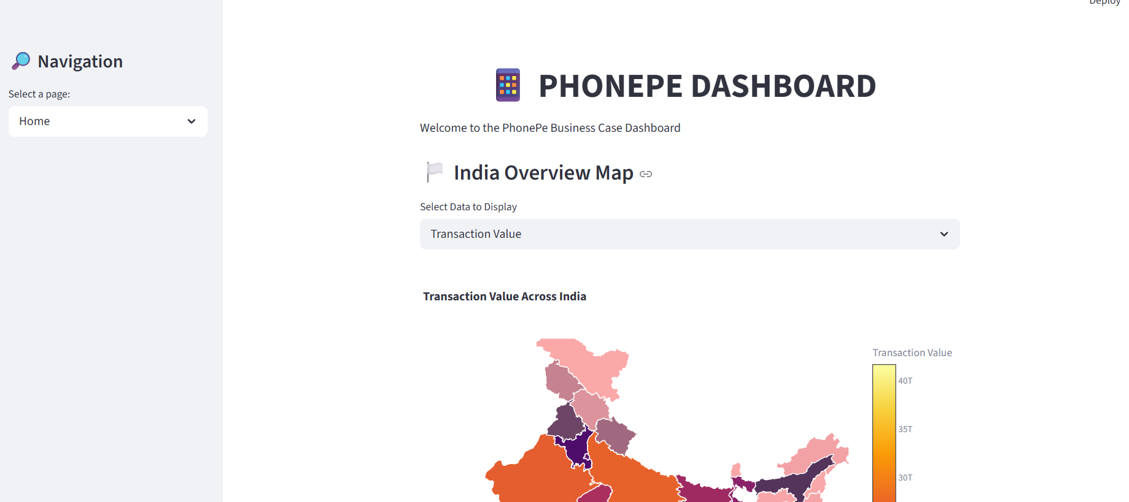
Dashboard DEMO

Slide 10
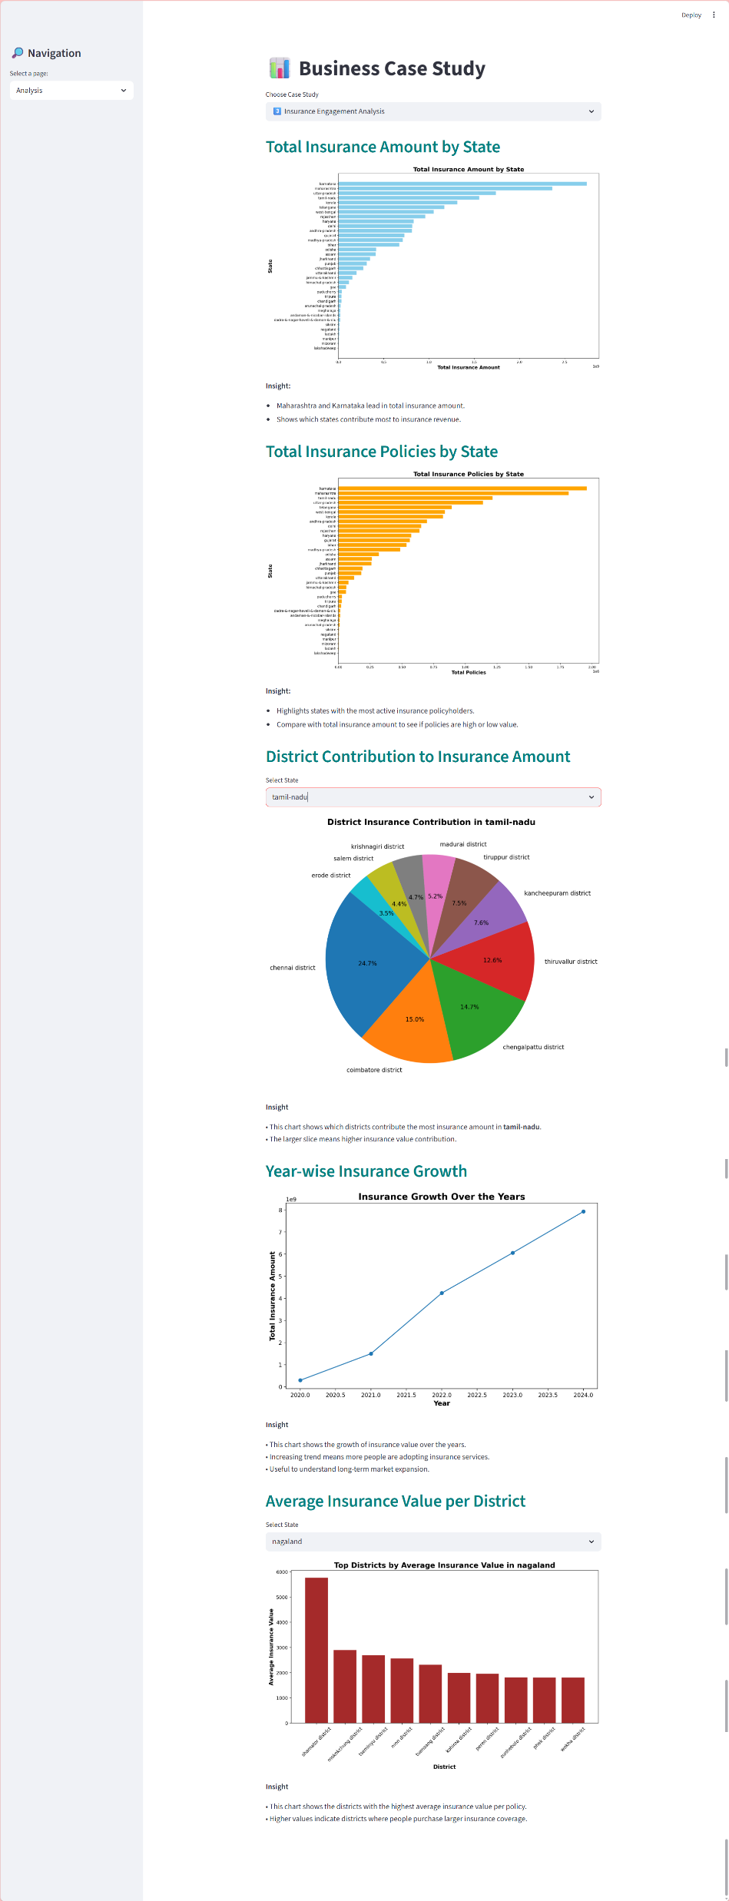
Dashboard Demo

Slide 11
Technical Data Flow
PhonePe Pulse Repo
Python Extraction
Data Transformation
MySQL Storage
Streamlit Visualization

Slide 12
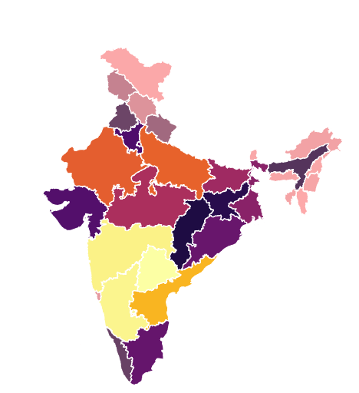
Key Insights
Digital payments show strong year-over-year growth
Maharashtra and Karnataka dominate transaction value
High user registrations correlate with app engagement
Insurance adoption is gradually increasing
Few districts contribute majority of transaction volume

Slide 13
Future Improvements
Add district-level interactive maps
Implement real-time data updates
Add machine learning prediction models
Deploy dashboard on cloud (Streamlit Cloud / AWS)

Slide 14
Thank you
Charanraj Sridharan
GitHub : https://github.com/CharanrajSridharan/phonepe-pulse-dashboard.git
Project: PhonePe Pulse Dashboard

